Slide 1
Topical Review 4
Correlation, Regression, Least Squares, Residuals, Regression Inference
TAs: Ravi Singhal, Oscar Syu, and Vikram Chandran

Slide 2

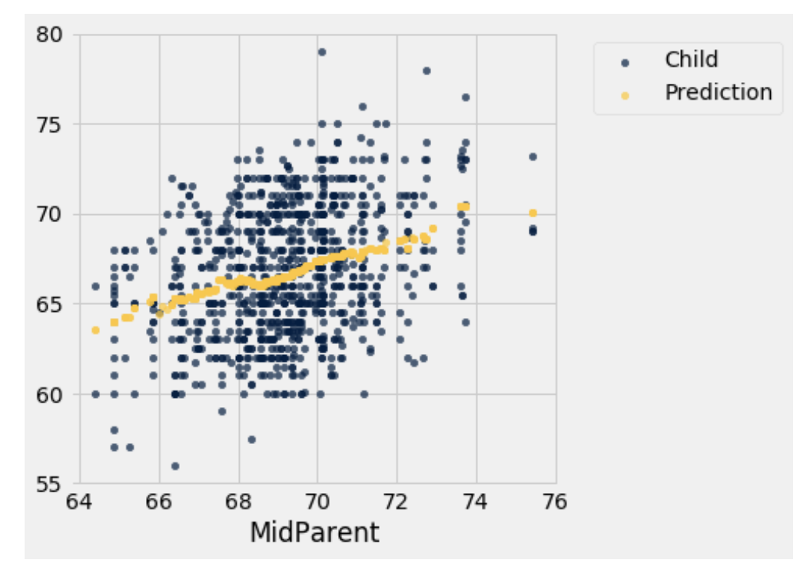
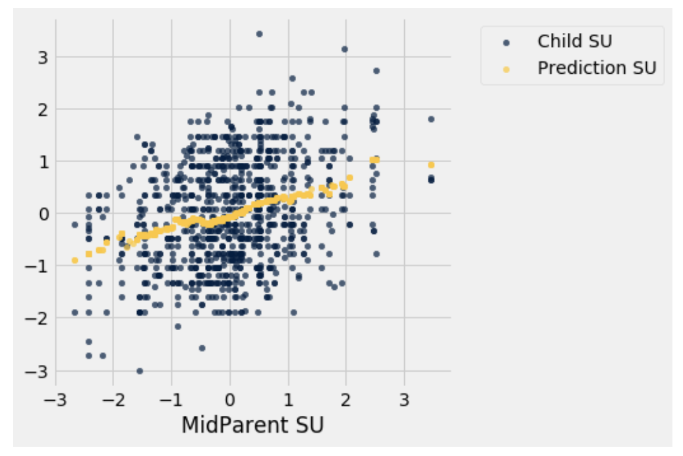
Standard Units
Notes:
We want to put

Slide 3
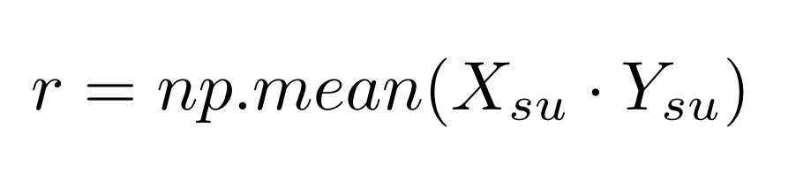
Correlation Coefficient (r)
r only measures linear association
-1 <= r <= 1
Always remember correlation does not imply causation!

Slide 4
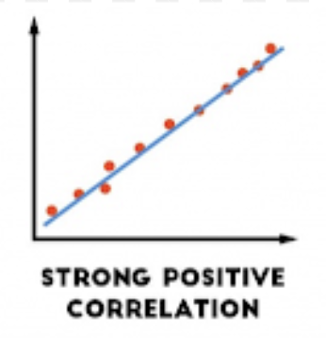
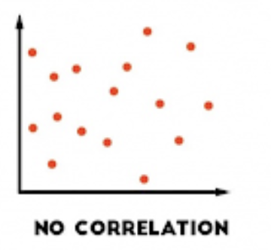
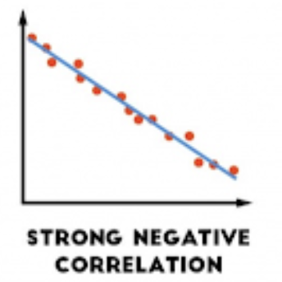
Correlation Coefficient (r)
r ~= 1
r ~= 0
r ~= -1

Slide 5
Correlation Coefficient (r)
A couple of notes about r:
r is unaffected by switching axes
r is unaffected by changing the original units for X and Y

Slide 6

Regression Line Formulas
The regression line is the “best-fit” line that minimizes the mean squared error
Regression Line: y_pred = slope*x + intercept
Notes:
Note: these formulas are when you are given x and y in regular (not standard) units, and want slope and intercept back in regular (not standard) units

Slide 7
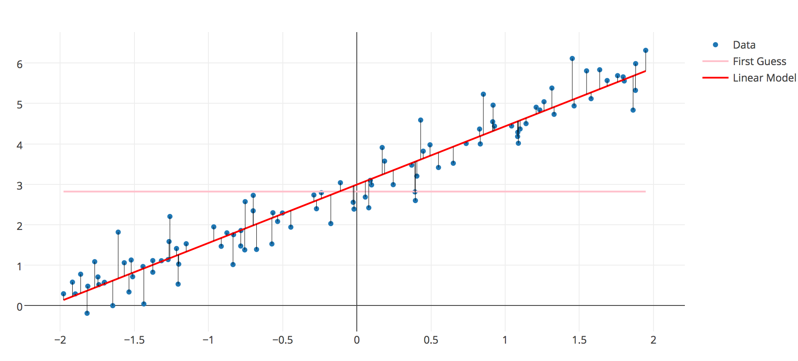
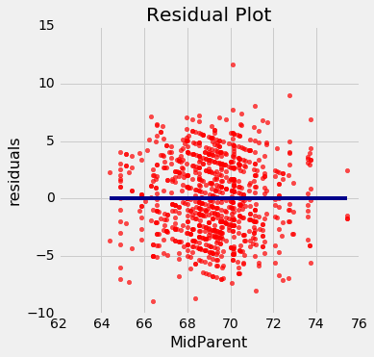
Residuals
Definition: the signed distance between the actual and the fitted values
Plot of residuals should look like a formless cloud if the data are linear (right)
Residual = actual_y - predicted_y

Slide 8
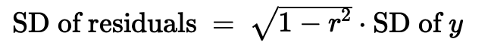
Residuals
If we are using the best fit line to make predictions, then no matter the shape of the scatter diagram,
Average of residuals = 0
Residual = actual_y - predicted_y

Slide 9
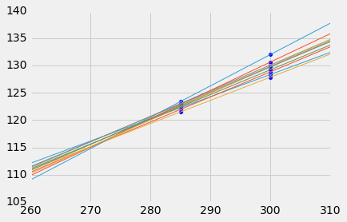
Confidence Interval for Prediction
We can generate a confidence interval for our prediction of y at a given value of x.
Each line used in prediction comes from a different resample of the data, generating a new line and many different predictions
As x gets farther from the mean of x’s, prediction intervals generally get wider (see visualization)

Slide 10
What should I be studying?
Know how to use the formulas for r, standard units, slope, and intercept when given data
Know the relationship between residuals and predictions, and how to understand a residual plot
How to generate prediction intervals (bootstrap)
Resample points (x-y pairs)
Generate a regression line for each resample
Use each line to make a prediction for y
Get a confidence interval of those predictions

Slide 11
Conceptual Understanding (T/F)
If it’s inappropriate to use linear regression on some data, the residual plot for that data will not have an average of 0.
If it’s inappropriate to use linear regression on some data, the residual plot for that data will show a pattern.
If I score 2 SD above the mean on the first midterm, the theory of regression will predict that I will score 2 SD above the mean on the second midterm as well

Slide 12
Conceptual Understanding (T/F)
If it’s inappropriate to use linear regression on some data, the residual plot for that data will not have an average of 0.
False, residuals will always have an average of 0
If it’s inappropriate to use linear regression on some data, the residual plot for that data will show a pattern.
True, this is how you determine whether a regression is appropriate or not
If I score 2 SD above the mean on the first midterm, the theory of regression will predict that I will score 2 SD above the mean on the second midterm as well
False, regression is about finding a graph of averages, and the regression will actually predict you get closer to the mean (regression to the mean)

Slide 13
More questions
[T/F] Suppose the correlation coefficient, r, between number of athletes active in competition and age was -0.85. We should conclude that age is correlated with number of active athletes.
If the correlation of hours using a laptop and near-sightedness is 0.7, what is the correlation of near-sightedness and hours on a laptop?

Slide 14
More questions
[T/F] Suppose the correlation coefficient, r, between number of athletes active in competition and age was -0.85. We should conclude that age is correlated with number of active athletes.
True, we can determine a negative association.
If the correlation of hours using a laptop and near-sightedness is 0.7, what is the correlation of near-sightedness and hours on a laptop?
r = 0.7. Switching the axes does not change r.

Slide 15
More Questions
3. In the calculation of root mean squared error, why is it important for us to square the residual before taking the sum?

Slide 16
More Questions
3. In the calculation of root mean squared error, why is it important for us to square the residual before taking the sum?
Because if we don’t square them, then the sum of the differences will be zero. The positives and the negatives will cancel each other out. Squaring our residuals gets rid of the negatives, giving us a better way of quantifying error.

Slide 17
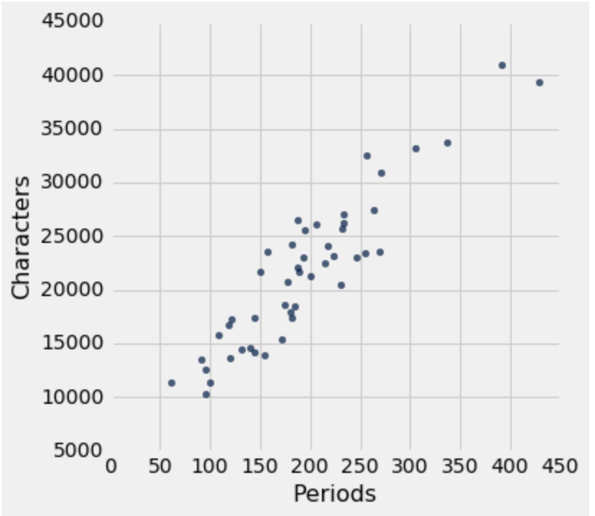
Confidence Intervals for Prediction
Discuss: Using the sample of chapters shown to the right, how can I estimate the number of characters in a chapter given that I know there are 200 periods in the chapter?
Discuss: If I had a different sample, would my estimate stay the same or be different? Why?

Slide 18
Confidence Intervals for Prediction
Using the sample of chapters shown to the right, how can I estimate the number of characters in a chapter given that I know there are 200 periods in the chapter?
Find the regression line using the sample. The x-variable is Periods and the y-variable is Characters. Then predict the # Characters by plugging in x=200 Periods.

Slide 19
Confidence Intervals for Prediction
If I had a different sample, would my estimate stay the same or be different? Why?
Different, because we will have a different regression line

Slide 20
Confidence Intervals for Prediction
With a different sample, I might get a different prediction for x = 200 Periods.
Briefly discuss how I can quantify how different my predictions could be with different samples? What if I only have one original sample with no time or money to get new samples from the population?

Slide 21
Confidence Intervals for Prediction
Briefly discuss how I can quantify how different my predictions could be with different samples? What if I only have one original sample with no time or money to get new samples from the population?
Bootstrap data many times and get a prediction for x=200 periods each time. Then compute a confidence interval that shows us where most of the predictions are.

Slide 22
Confidence Intervals for Prediction
If I generate a confidence interval for predictions of the number of characters given x = 200 periods in the chapter, the interval contains predictions of the height of
The regression line
The true line in the regression model
At x = 200. Why?

Slide 23
Confidence Intervals for Prediction
If I generate a confidence interval of predictions of the number of characters given x = 200 periods in the chapter, the interval contains predictions of the height of
The regression line
The true line in the regression model
at x = 200. Why?
b) We already have the height of the regression line at x = 200 for the given data. We use confidence intervals to estimate the heights given by the true line. Remember that confidence intervals are usually used to provide a range of estimates for a population parameter.
Notes:
Think about what the parameter is in this case- the predicted value of x=200 of the underlying regression line/model from which the data comes from, not that of the regression line for this sample.

Slide 24
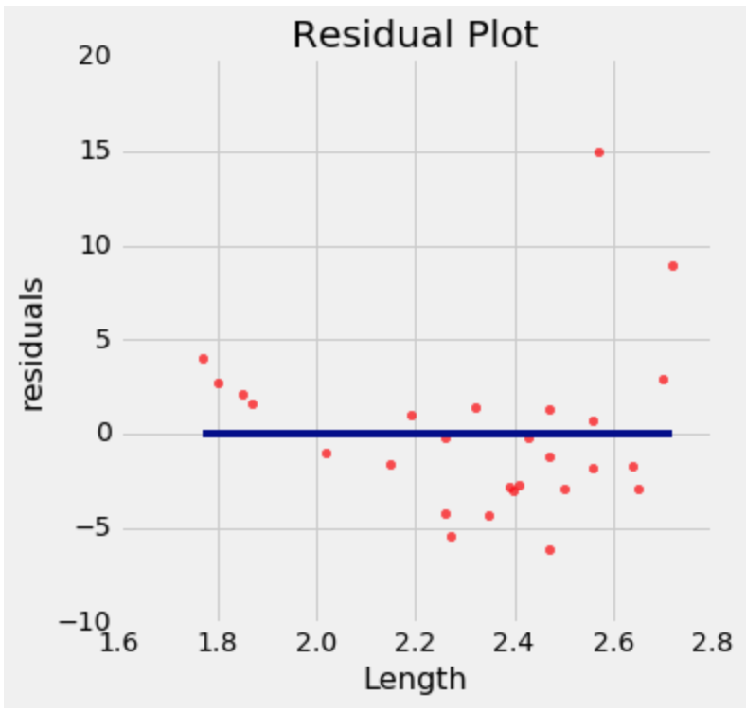
Residual Patterns
Was this residual plot generated from
Linear data
Non-linear data
Why?
Notes:
Residual plot is Dugong example in textbook https://www.inferentialthinking.com/chapters/13/5/visual-diagnostics.html

Slide 25
Residual Patterns
Was this residual plot generated from
Linear data
Non-linear data
Why?
B) The residuals are positive for small and large values of x, but negative for medium values of x.
Pattern: too high, too low, too high
Notes:
Residual plot is Dugong example in textbook https://www.inferentialthinking.com/chapters/13/5/visual-diagnostics.html

Slide 26
Warm-up
Current Income | Growth
11 | -0.4%
12 | -0.4%
13 | -0.3%
14 | -0.3%
15 | -0.2%
16 | -0.2%
17 | -0.2%
18 | -0.1%
19 | -0.1%
20 | -0.1%
Suppose we have a table named income_growth with two columns named Current_Income (in thousands of dollars) and Growth (in percentage points). Assuming incomes are distributed normally, the mean current income is 66.29, and the standard deviation is 29.65. The mean income growth is 1.423% and the standard deviation is 1.484.
Suppose we would like to find out how far each person’s income is from the mean income, in terms of squared distance. Write down a python expression that would do this.

Slide 27
Warm-up
Current Income | Growth
11 | -0.4%
12 | -0.4%
13 | -0.3%
14 | -0.3%
15 | -0.2%
16 | -0.2%
17 | -0.2%
18 | -0.1%
19 | -0.1%
20 | -0.1%
Suppose we would like to find out how far each person’s income is from the mean height, in terms of squared distance. Write down a python expression that would do this.
Solution
(income_growth.column(‘Current Income’) - 66.29) ** 2

Slide 28
Warm-up
Current Income | Growth
11 | -0.4%
12 | -0.4%
13 | -0.3%
14 | -0.3%
15 | -0.2%
16 | -0.2%
17 | -0.2%
18 | -0.1%
19 | -0.1%
20 | -0.1%
Suppose we have a table named income_growth with two columns named Current_Income (in thousands of dollars) and Growth (in percentage points). Assuming incomes are distributed normally, the mean current income is 66.29, and the standard deviation is 29.65. The mean income growth is 1.423% and the standard deviation is 1.484.
B. Now we would like to find the slope of the line to predict growth using Current_Income. Write code to achieve this.

Slide 29
Warm-up
Current Income | Growth
11 | -0.4%
12 | -0.4%
13 | -0.3%
14 | -0.3%
15 | -0.2%
16 | -0.2%
17 | -0.2%
18 | -0.1%
19 | -0.1%
20 | -0.1%
B. Now we would like to find the slope of the regression of Current_Income on growth. Write code to achieve this.
Solution
y_su = (income_growth.column(‘Growth’)-1.423)/1.484
x_su = (income_growth.column(‘Current Income’)-66.29) /29.65
slope = np.mean(x_su * y_su) * 1.484 / 29.5
Notes:
We know that the r= x_su * y_su
And slope = r * np.std(y)/np.std(x)

Slide 30
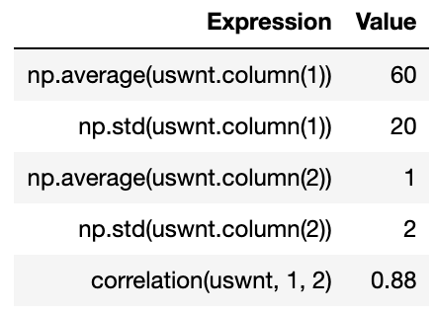
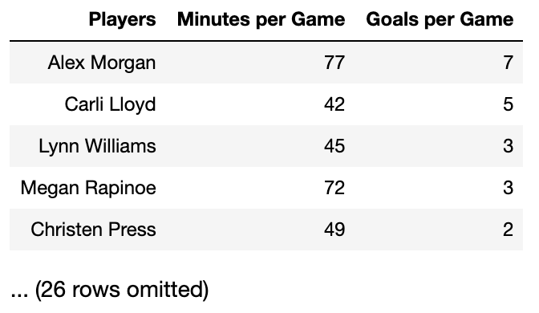
Problem 1
Predictions
The uswnt table contains player data for the U.S. Women’s National Soccer Team. Only the first five rows are shown. You have computed the following summary statistics from the full uswnt table.
What is the value of Alex Morgan’s goals per game in standard units?

Slide 31
Problem 1
Predictions
The uswnt table contains player data for the U.S. Women’s National Soccer Team. Only the first five rows are shown. You have computed the following summary statistics from the full uswnt table.
What is the value of Alex Morgan’s goals per game in standard units?
(7 - mean_{goals/game}) / SD_{goals/game} = (7-1) / 2 = 3

Slide 32
Problem 1
Predictions
The uswnt table contains player data for the U.S. Women’s National Soccer Team. Only the first five rows are shown. You have computed the following summary statistics from the full uswnt table.
b) What is the slope of the regression line when the goals per game are plotted on the vertical axis, the minutes per game are plotted on the horizontal axis, and a regression line is fit to the data? That’s the slope of the regression line computed by slope(uswnt, 1, 2) in original units, goals/minutes.

Slide 33
Problem 1
Predictions
The uswnt table contains player data for the U.S. Women’s National Soccer Team. Only the first five rows are shown. You have computed the following summary statistics from the full uswnt table.
b) What is the slope of the regression line when the goals per game are plotted on the vertical axis, the minutes per game are plotted on the horizontal axis, and a regression line is fit to the data? That’s the slope of the regression line computed by slope(uswnt, 1, 2) in original units, goals/minutes.
r * (SD_{y})/(SD_{x}) = .88 * (2/20) = 0.088

Slide 34
Problem 1
c) How would the fitted value of goals per game for a player who played 50 minutes per game change if Carli Lloyd were removed from the table and the regression line recomputed? Circle one.
(a) Increase (b) Decrease (c) Stay the same (d) Not enough info

Slide 35
Problem 1
c) How would the fitted value of goals per game for a player who played 50 minutes per game change if Carli Lloyd were removed from the table and the regression line recomputed? Circle one.
(a) Increase (b) Decrease (c) Stay the same (d) Not enough info
b) Decrease, since Carli Lloyd had a high goals/minute ratio compared to the other players, which would have “pulled up” the original regression line. With Lloyd removed, the regression line would be flatter, giving smaller predictions.

Slide 36
Problem 1
Predictions
The uswnt table contains player data for the U.S. Women’s National Soccer Team. Only the first five rows are shown. You have computed the following summary statistics from the full uswnt table.
d) What is the fitted value for Megan Rapinoe using this regression line to estimate her goals per game from her minutes per game?

Slide 37
Problem 1
d) What is the fitted value for Megan Rapinoe using this regression line to estimate her goals per game from her minutes per game?
Intercept = mean_{y} - slope * mean_{x} = 1 - 0.088(60) = -4.28
Prediction = 0.088(72) - 4.28 = 2.05 = 2
Notes:
Use slope from part b: r * (SD_{y})/(SD_{x}) = .88 * (2/20) = 0.088
Intercept = mean(y) - slope* mean(x) = -4.28
Plug into equation

Slide 38
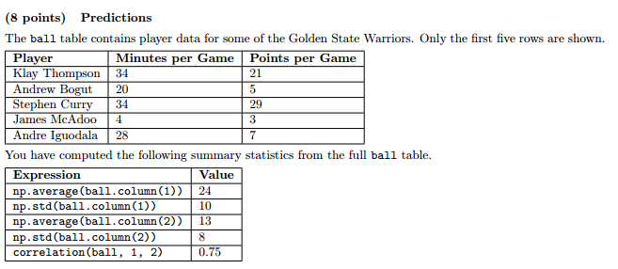
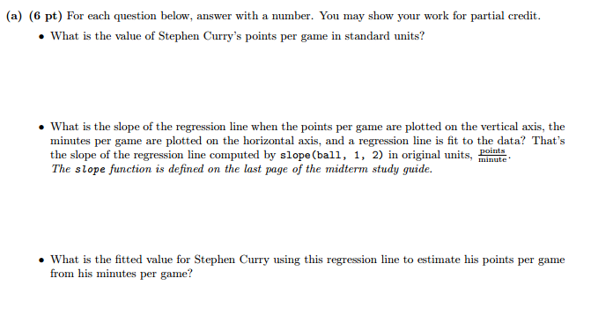
Spring 2016 Midterm
(29 - mean_{pts/game}) / SD_{pt/game} = (29 - 13) / 8 = 2

Slide 39
Spring 2016 Midterm

Slide 40
Spring 2016 Midterm
r * (SD_{y})/(SD_{x}) = .75 * (8 / 10) = .6

Slide 41
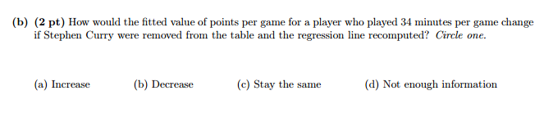
Spring 2016 Midterm

Slide 42
Spring 2016 Midterm
b) Decrease, since Steph Curry had a high points/minute ratio compared to the other players, which would have “pulled up” the original regression line. With Curry removed, the regression line would be flatter, giving smaller predictions.

Slide 43
Spring 2016 Midterm

Slide 44
Spring 2016 Midterm
Intercept = mean_{y} - slope * mean_{x} = 13 - .6(24)
Prediction = 0.6(34) + 13 - 0.6(24) = 19

Slide 45
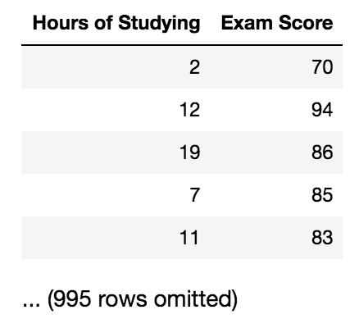
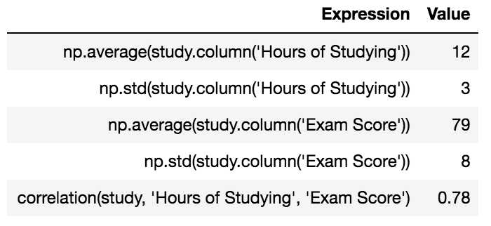
Problem 2
The study table (left) contains one row per student in a study of 1000 students’ Hours of Studying and their Score on Data 8 Final. Assume that the data were collected by sampling students at random from a very large population. Summary statistics (right) are shown below.
What is the value of correlation(study, “Exam Score”, “Hours of Studying”)?

Slide 46
Problem 2
The study table (left) contains one row per student in a study of 1000 students’ Hours of Studying and their Score on Data 8 Final. Assume that the data were collected by sampling students at random from a very large population. Summary statistics (right) are shown below.
What is the value of correlation(study, “Exam Score”, “Hours of Studying”)?
0.78

Slide 47
Problem 2
The study table (left) contains one row per student in a study of 1000 students’ Hours of Studying and their Score on Data 8 Final. Assume that the data were collected by sampling students at random from a very large population. Summary statistics (right) are shown below.
(b) Write the equation of the regression line for the Exam Score y in terms of Hours of Studying x.
Remember...
Slope = r * np.std(y) / np.std(x)
Intercept = np.mean(y) - np.mean(x) * slope

Slide 48
Problem 2
The study table (left) contains one row per student in a study of 1000 students’ Hours of Studying and their Score on Data 8 Final. Assume that the data were collected by sampling students at random from a very large population. Summary statistics (right) are shown below.
(b) Write the equation of the regression line for the Exam Score y in terms of Hours of Studying x.
y = 0.78 * 8/3 * x + 79 - 12 * (0.78 * 8/3) = 2.08x + 54.04

Slide 49
Problem 2
The study table (left) contains one row per student in a study of 1000 students’ Hours of Studying and their Score on Data 8 Final. Assume that the data were collected by sampling students at random from a very large population. Summary statistics (right) are shown below.
(c) What is the estimated average Exam Score of a student who studied 2 standard deviations above the mean Hours of Studying? Use the regression line to find this estimate.

Slide 50
Problem 2
The study table (left) contains one row per student in a study of 1000 students’ Hours of Studying and their Score on Data 8 Final. Assume that the data were collected by sampling students at random from a very large population. Summary statistics (right) are shown below.
(c) What is the estimated average Exam Score of a student who studied 2 standard deviations above the mean Hours of Studying? Use the regression line to find this estimate.
x in standard units = 2
Predicted y in standard units = r*x_su = 0.78(2) = 1.56
Convert predicted y to original units: y = (1.56) * 8 + 79 = 91.48

Slide 51
Problem 2
The study table (left) contains one row per student in a study of 1000 students’ Hours of Studying and their Score on Data 8 Final. Assume that the data were collected by sampling students at random from a very large population. Summary statistics (right) are shown below.
(d) The high correlation coefficient seems too good to be true and we are concerned that the correlation we calculated from this sample is a fluke, so we want to compute a confidence interval for the true correlation. What are our null and alternative hypotheses in this testing scheme?
Null:
Alternative:

Slide 52
Problem 2
The study table (left) contains one row per student in a study of 1000 students’ Hours of Studying and their Score on Data 8 Final. Assume that the data were collected by sampling students at random from a very large population. Summary statistics (right) are shown below.
(d) The high correlation coefficient seems too good to be true and we are concerned that the correlation we calculated from this sample is a fluke, so we want to compute a confidence interval for the true correlation. What are our null and alternative hypotheses in this testing scheme?
Null: the true correlation is 0.
Alternative: the true correlation is not 0.

Slide 53
Problem 2
(e) We are concerned that the correlation we calculated from this sample is a fluke, so we want to compute a 95% confidence interval for the true correlation. Please take 10,000 resamples. Assume the function correlation(tbl, x_label, y_label) is defined for you.
correlations = make_array()
for i in _______________:
bootstrap_sample = ______________
bootstrap_correlation = ________________
correlations = ____________________
conf_int = make_array(_________________, ________________)

Slide 54
Problem 2
(e) We are concerned that the correlation we calculated from this sample is a fluke, so we want to compute a 95% confidence interval for the true correlation. Please take 10,000 resamples. Assume the function correlation(tbl, x_label, y_label) is defined for you.
correlations = make_array()
for i in np.arange(10000):
bootstrap_sample = study.sample()
bootstrap_correlation = correlation(bootstrap_sample, “Hours of Studying”, “Exam Score”)
correlations = np.append(correlations, bootstrap_correlation)
conf_int = make_array(percentile(2.5, correlations), percentile(97.5, correlations))

Slide 55
Problem 2
The study table (left) contains one row per student in a study of 1000 students’ Hours of Studying and their Score on Data 8 Final. Assume that the data were collected by sampling students at random from a very large population. Summary statistics (right) are shown below.
(f) Say we calculated a confidence interval of (0.05, 0.35). Do we reject or fail to reject the null hypothesis? What does this mean in words?

Slide 56
Problem 2
The study table (left) contains one row per student in a study of 1000 students’ Hours of Studying and their Score on Data 8 Final. Assume that the data were collected by sampling students at random from a very large population. Summary statistics (right) are shown below.
(f) Say we calculated a confidence interval of (0.05, 0.35). Do we reject or fail to reject the null hypothesis? What does this mean in words?
Reject. The correlation of 0 is, with 95% confidence, not in the confidence interval, so there is some association between Hours of Studying and Exam Score. So start studying!

Slide 57
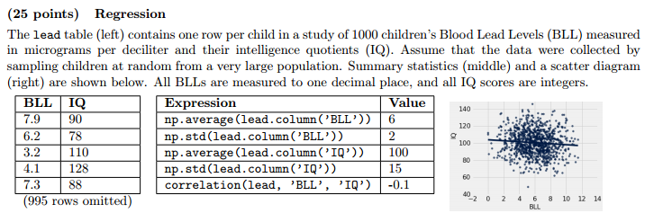
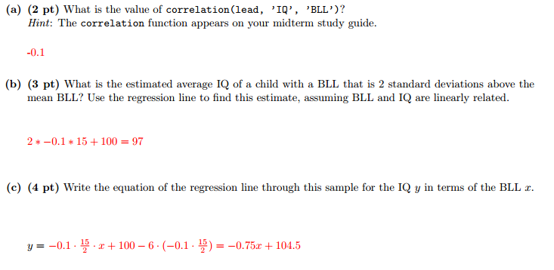
Spring 2016 Final
-0.1

Slide 58
Spring 2016 Final

Slide 59
Spring 2016 Final
x in su = 2
Predicted y in su = r*x_su = -0.1(2) = -0.2
Convert predicted y to original units: y = (-0.2) * 15 + 100

Slide 60
Spring 2016 Final

Slide 61
Spring 2016 Final

Slide 62
Spring 2016 Final
Despite calculating a small negative correlation, we are concerned that the correlation we calculated from this sample is a fluke, so we want to compute a confidence interval for the true correlation. What are our null and alternative hypotheses in this testing scheme?
Null is:
Alternative is:

Slide 63
Spring 2016 Final
Despite calculating a small negative correlation, we are concerned that the correlation we calculated from this sample is a fluke, so we want to compute a confidence interval for the true correlation. What are our null and alternative hypotheses in this testing scheme?
Null is: the true correlation is 0.
Alternative is: the true correlation is not 0.

Slide 64
Spring 2016 Final
We are concerned that the correlation we calculated from this sample is a fluke, so we want to compute a 95% confidence interval for the true correlation. Assume the function correlation(tbl, x_label, y_label) is defined for you.
correlations = make_array()
for i in _______________:
bootstrap_sample = ______________
bootstrap_correlation = ________________
correlations = ____________________
conf_int = make_array(_________________, ________________)

Slide 65
Spring 2016 Final
correlations = make_array( )
for i in np.arange(10000):
bootstrap_sample = lead.sample( )
bootstrap_correlation = correlation(bootstrap_sample, “BLL”, “IQ”)
correlations = np.append(correlations, bootstrap_correlation)
conf_int = make_array(percentile(2.5, correlations),
percentile(97.5, correlations))

Slide 66
Spring 2016 Final
Say we calculated a confidence interval of (-0.17, -.02). Do we reject or fail to reject the null hypothesis? What does this mean in words?

Slide 67
Spring 2016 Final
Say we calculated a confidence interval of (-0.17, -.02). Do we reject or fail to reject the null hypothesis? What does this mean in words?
Reject. The correlation of 0 is, with 95% confidence, not in the confidence interval, so there IS some association between BLL and IQ.

